Slide 1
INTRODUCTION TO .NET FRAMEWORK
.Net framework is a software development platform developed by Microsoft for building and running windows applications
The .Net framework conists of developer tools,programming languages,and libraries to build desktop and web applications
It is also used to build websites,web services,and games
The .Net framework support more than 60 programming languages such as c#,F#,VB.NET,J#,VC++,python,smalltalk,cobra,….etc,

Slide 2
The .NET framework is composed of four main components:
1.Common Language Runtime (CLR)
2.Framework Class Library(FCL)
3.Core Languages(winforms,ASP.NET,ADO.NET)
4.Other Modules (WCF,WPF,WF,Card Space,LINQ,Entity Framework,..etc)

Slide 3
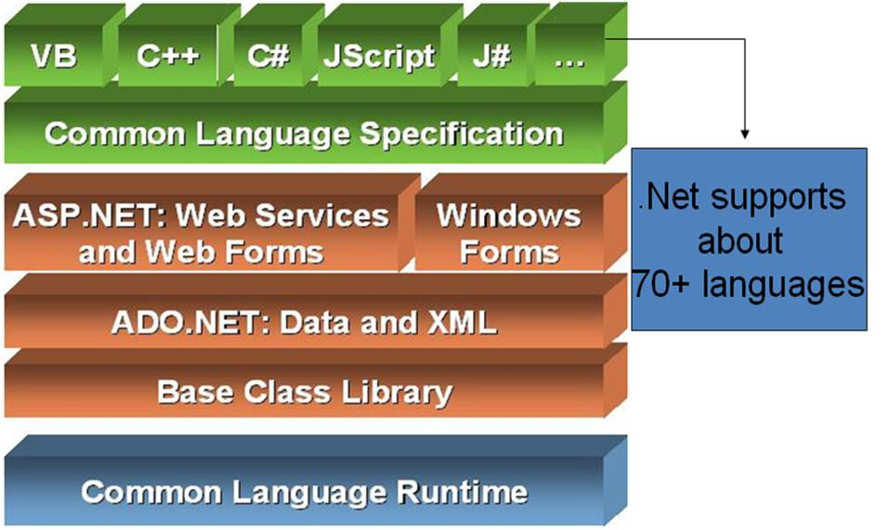

Slide 4
CLR(common language runtime)
The CLR in the .NET Framework is the Virtual Machine component that handles program execution for various languages such as C#, F#, Visual Basic .NET, etc. The managed execution environment is provided by giving various services such as memory management, security handling, exception handling, garbage collection, thread management, etc. The Common Language Runtime implements the VES (Virtual Execution System) which is a run time system that provides a managed code execution environment. The VES is defined in Microsoft’s implementation of the CLI (Common Language Infrastructure).
Architecture of Common Language Runtime
A diagram that demonstrates the architecture of Common Language Runtime is given as follows:

Slide 5
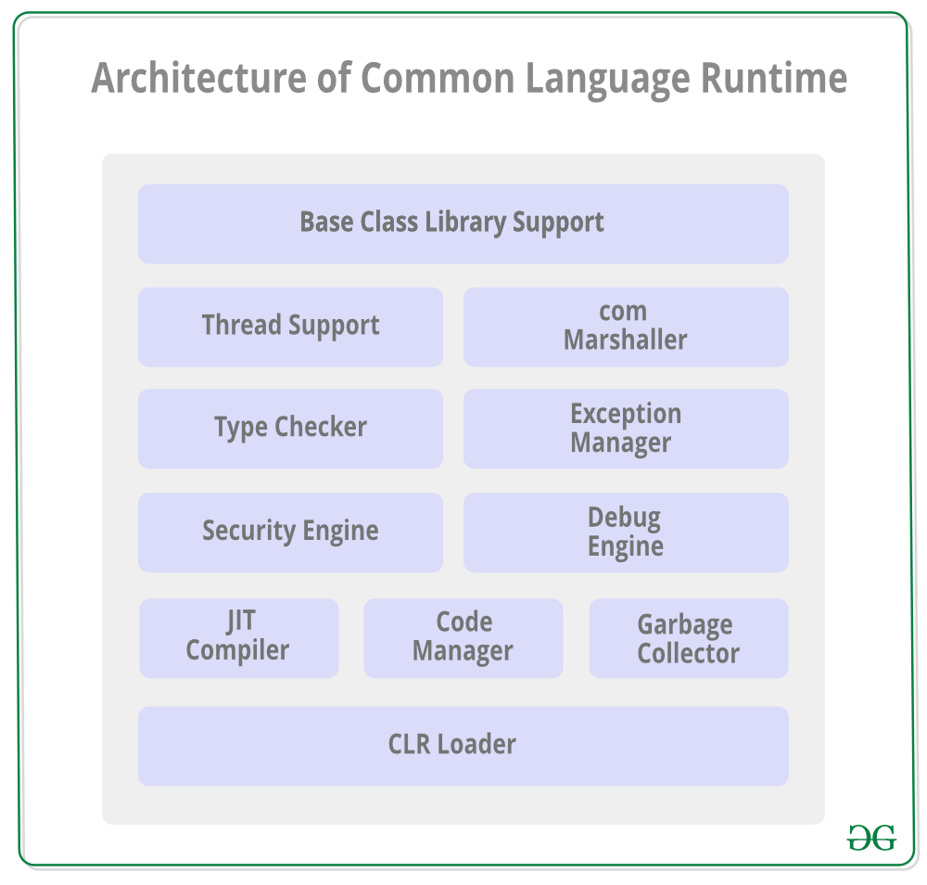

Slide 6

FCL(framework class library)
The Framework Class Library or FCL provides the system functionality in the as it has various classes, data types, interfaces, etc.
to perform multiple functions and build different types of applications such as desktop applications, web applications, mobile applications, etc.
The Framework Class Library is integrated with the Common Language Runtime (CLR) of the .NET framework and is used by all the .NET languages such as C#, F#, Visual Basic .NET, etc.

Slide 7
WINForms
Windows Forms (WinForms) is a free and open-source graphical (GUI) class library included as a part of Microsoft . NET, . NET Framework or Mono Framework, providing a platform to write client applications for desktop, laptop, and tablet PCs. ... NET Core framework.
ASP
ASP.NET Core is the open-source version of ASP.NET, that runs on macOS, Linux, and Windows. ASP.NET Core was first released in 2016 and is a re-design of earlier Windows-only versions of ASP.NET.
LINQ
LINQ is a data querying API that provides querying capabilities to . NET languages with a syntax similar to a SQL. LINQ queries use C# collections to return data. LINQ in C# is used to work with data access from sources such as objects, data sets, SQL Server, and XML.
a

Slide 8
.NET CLR
Common Language Runtime, the virtual machine component of Microsoft .NET Framework, manages the execution of .NET programs. Just-in-time compilation converts the managed code into machine instructions which are then executed on the CPU of the computer.
.NET CLR FUNCTIONS
Convert code into CLI.
Exception handling.
Type safety.
Memory management (using the Garbage Collector)
Security.
Improved performance.
Language independency.
Platform independency.

Slide 9
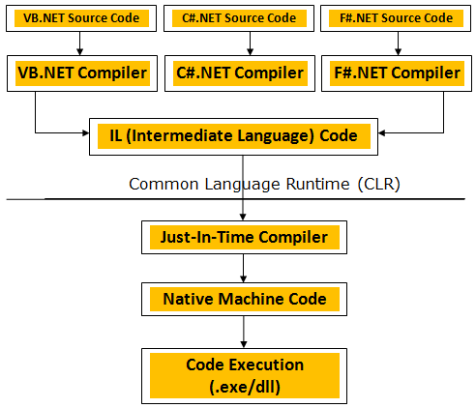
.NET CLR VERSIONS
The CLR Version tool (Clrver.exe) reports all the installed versions of the common language runtime (CLR) on the computer. This tool is automatically installed with Visual Studio. To run the tool, use Visual Studio Developer Command Prompt or Visual Studio Developer PowerShell
.NET CLR STRUCTURE

